Slide 1
Computer Based Reservation System
Mwayi Mchuchu

Slide 2
Introduction to reservation systems
In 1946, American Airlines installed the first automated booking system, the experimental electromechanical Reservoir. A newer machine with temporary storage. This system proved successful, and was soon being used by several airlines, as well as Sheraton Hotels and Goodyear for inventory control.
A computer reservation system or central reservation system (CRS) is a computerized system used to store and retrieve information and conduct transactions related to air travel, hotels, car rental, or other activities.
Originally designed and operated by airlines, CRSs were later extended for the use of travel agencies.
In the tourism industry Computer Reservation System (CRS) can be defined as, an information system that promotes sales and provides fast and accurate information about availability, price and bookings of tourism products and services
Today, CRSs are of high importance for travel and tourism industry with the main focus on direct reservations (e.g. directly in the hotel)

Slide 3
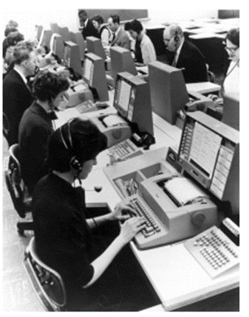
CRS History COntinued
In 1962 American Airlines introduced SABRE (Semi-Automated Business Research Environment) the first commercial CRS, developed by IBM, that was used for:
generating flight plans for the aircraft
tracking spare parts
scheduling crews
CRS is the first information system that was used in tourism industry

Slide 4
CRS Functions (in the Airline)
Flight schedule information
Days and times for flights operated by the airline ▪ Availability information
Seat availability on a flight by service class (i.e. Economy, business, first class)
Fare quotes
A consolidated fare for an itinerary (schedule) based on flight, day, time, service class and passenger types chosen
Reservation information
Seat bookings
Ticketing information
Generating and storing tickets
Refunds and cancellations
Cancellation of existing reservations and tickets

Slide 5
Global Distribution System
Developments of the CRS led to the Travel Agent Specialized Systems, then later to Global Distribution System.
GDS is an integrated information system and communication channel that:
incorporates all travel services
connects service providers with end users
providing information from all segments of the journey
allows booking and selling of the required services
Today GDS is:
the most cost effective tool for buyers of business travel to manage the complexity of supply
more than just a reservation tool - integrates the core business processes of tourism businesses and therefore increase their productivity, speed, and performance

Slide 6
GDS continued
Global distribution systems (GDS) book and sell tickets for multiple airlines, or can act as agent booking for multiple Hotels. Usually their web based systems will have list of service providers and price list on similar service. Site also enable consumer access through Internet gateways.
Modern GDS's typically allow users to book hotel rooms, rental cars, airline tickets as well as other activities and tours. They also provide access to railway reservations and bus reservations in some markets.
These are also used to relay computerized information for users in the hotel industry, making reservation and ensuring that the hotel is not overbooked. (system will send booking info into PMS to ensure there is on prompt system update to avoid overbooking)

Slide 7
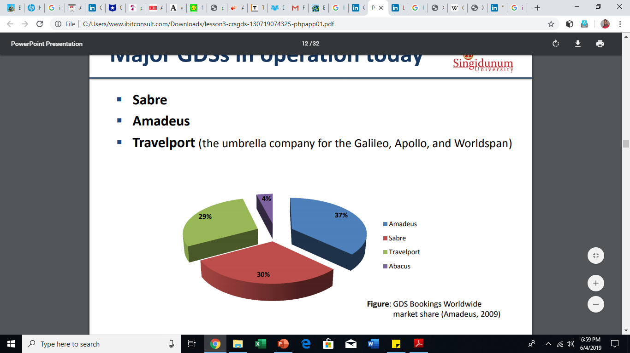
Major GDS in use today.
Sabre
Amadeus
Travelport (the umbrella company for the Galileo, Apollo, and Worldspan)

Slide 8
GDS Organisations
In order to promote fair competition and to ensure that consumers do not receive inaccurate or misleading information on travel services, it is necessary to have regulations on GDS
Organisations work together with governments, and other relevant authorities to help define the correct regulatory framework for the travel and transport industry
There are several organisations, such as:
IATA - International Air Transport Association
ICAO - International Civil Aviation Organization
ETTSA - European Technology and Travel Services Association
ATPCO - Airline Tariff Publishing Company
IATAN - International Airlines Travel Agent Network
SITA - Société Internationale and many others

Slide 9
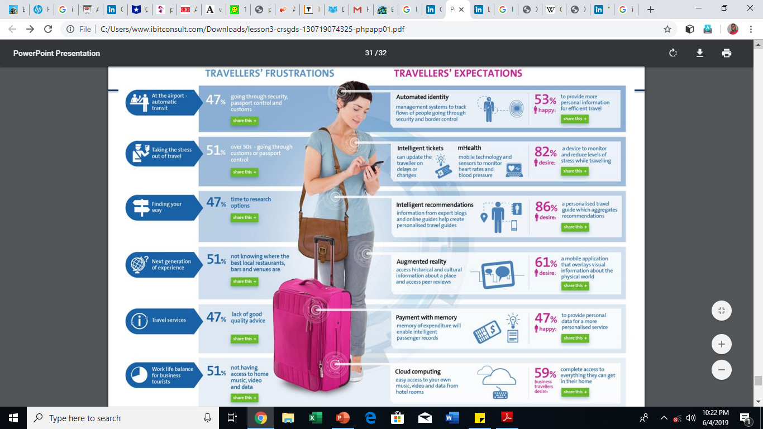

Slide 10
GDS Advantages
It’s a unique (and direct) marketing tool. A global distribution system can be used to market your latest sales message, special offers, and discounts directly to travel agents. In 2017, 69% of travel agents reported being aware of promotion text from a GDS.
It improves search positioning. Gaining access to a GDS means that travel agents and consumers are more easily able to find your hotel during search.
It has perfect timing. The GDS displays your brand messaging and advertising during the search and booking process, which means travel agents are paying attention at exactly the right time. Messages can also be targeted at precise dates and times, by specific destinations.

Slide 11
GDS Disadvantages
A GDS can be an asset, but there are many hotels that chose to seek bookings through other means. With the uncertainty of the travel industry, many properties are looking for ways to cut costs and with a high ticket price, GDS’s are often one of the first to go. Some of the most common reasons hotels chose to opt out of using a GDS are:
Money. The price of GDS’s alone is a deterrent for many properties. As a growing business, your funds may be better invested in other areas of your property.
Priorities. Retaining customers is more important than bringing in new ones. Making sure that guests are comfortable with clean rooms, abundant amenities and a welcoming staff should be your first order of business.
Declining audience. One of the benefits of a GDS is that it catches the corporate traveler segment, but business travel growth is slowing.

Slide 12
references
Dennis, B. (2012). Hospitality Internet Booking Engines & Central Reservation Systems: A thought-piece concerning online reservation technology for the hospitality industry. Buuteeq, Seattle, WA.
Amdekar, J., Padmanabhuni, S. (2006). Future of Travel & Tourism Industry with the adoption of Web Services in Electronic Distribution. Infosys. Available at: http://www.infosys.com/industries/hospitality-leisure/white-papers/Documents/webservices-adoption-travel-tourism.pdf (accessed 4.06.2019)
ETTSA (2010). Technology and Independent Distribution in the European Travel Industry. PhoCusWright . Available at: http://www.ettsa.eu/uploads/documents/ETTSA_Study_2010_Single_Pages.pdf (accessed 4.06.2019)

Slide 13
Inter sell agencies
An Intersell agency is a central reservation system that contracts to handle more than one product line.
All reservation services are managed by one central reservation system.
intersell agencies typically handle reservation services for airline companies, car rental companies, and hotel properties - a "one call does it all" approach.
These agencies channel their room reservation requests to a central reservation system, but they may also communicate directly with hotels.
Think of intersell agencies as local players of GDS, Hotel managers can register their hotels with GDS and can also subcribe to intersell agencies at the same time running their own web based Reservation System powered by PMS or other independent Reservation Systems

Slide 14
Affiliate and non-affiliate systems
refers to a hotel chain’s reservation system where all the participating properties are contractually related. Hotel chains link their reservation operations to reduce overall system costs and simplify the processing of reservations.
The main advantages of an affiliate reservation system are as follows:
Streamlines the process of reservation
Reduce overall system costs
Attracts business to another property of the chain
Referral may also be made to properties whose locations might appear more useful or appropriate to the guest’s needs.
In general think of affiliate reservation systems as a partial partnership of competitors towards same goal. We run or have come into contact with manual affiliate referrals in enquiring different services the concept of (ife tilibe koma funsani shop iyo, amakhara ndizolimba)

Slide 15
Non affiliate reservation systems
It is a system designed independent or non-chain properties.
Non –affiliate reservation networks allow autonomous hotel operators to enjoy many of the same benefits that chain affiliated operators do.
A non-affiliate network usually takes up the responsibility of advertising its services just like a affiliate reservation network. (think of sunbird they have a chain of sunbird hotels that may appear like different each with unique names deemed as independent but are all under one brand sunbird, so sunbird might run a web based central reservation that might advertise and provide booking service to a list of all its hotels)
Central reservation office, potential guest, and independent member hotels, are some of a non affiliate system modules.
depending upon the need of the hotel and type of the hotel one can choose between an Affiliate system or a non-affiliate system of Central Reservation System. For example non affiliate reservation systems might be suitable to service providers with a chain of service or product line.

Slide 16
Property Level Reservation Systems
It is a local hotel administrations ystem used for reservation, availability and occupancy management, check-in/out, images, guest profiles, report generation etc.
This application is used in-house (in an individual hotel) to control the onsite property activities.
In other words, it is reservation module under Property Management System.
Can easily locally be managed
Less costly as the license is being covered within theoveral PMS
Might not be effective for new market entrants as compared to subscribing to GDS or using intersell agencies.
How ever the good part is all three option can be adopted concurrently.(a hotel might use its Property level reservation system, Intersell agencies plus GDS) it all comes down to budgeting on the Information Technology investment

Slide 17
New developments in computer based reservation systems (Hotels and tourism centers)
High level of integration (most modern reservation systems are adopting more of integral approach)
Highly customizable Allowing an out of the ordinary event configuration setup within the system, for an event that so unique in the industry, think of a cry out event Like those in japan.
Cloud versus local (High rate of cloud based Reservation Systems than local)
GDS, Affiliate Systems is a more common route for many hotel service providers
Cost benefit analysis as major factor in selecting the reservation system approach is being taken into account by most tourism and hospitality service providers.

Slide 18
Key benefits of any reservation system
No More Booking Mistakes
Hotel booking systems provide an effective mechanism that does not allow two guests to book the same room at the same time, which makes the reservation process more efficient. To err is human and an online reservation system is a must-have for hotels these days.
Never Lose Track of Your Bookings
The solution lies in the successful implementation of a central reservation system (CRS). It will allow you, as well as your hotel personnel, to not only book travel arrangements with guests, but also to view these details across all computers in the same system. This will eliminate booking problems and confusion and at the same time will enable you to see when your busy season is and when people tend to book less often.
if you have hotels around the globe, you will still be able to connect all of them to a single central web-based reservation system so that you can see how many rooms guests have booked no matter the distance.

Slide 19
Key benefits of any reservation system(Continued)
Get to Know Your Customers
Identifying the buying patterns of your guests can be crucial when developing a better relationship with them. The building blocks of the hospitality industry are mostly services and long-term relationships with guests.
Less operation cost and profit as compared to a manual system
A reservation software for hotels that is compatible with all kinds of distribution systems offers a great advantage to the hospitality industry:
hotel CRS can reduce the burden on the management of the hotels.
you can now easily track the reservations made months ahead and feel confident that you will not lose them as some client will pay upfront.
Beneficial to customers
A central reservation system is an effective and time-saving tool. Your guests can take advantage of your special offers and promotions, and add extras to their stay.
User friendliness in terms of changing checking time,dates or cancelation. Most booking facilities will offer such key options at a click of a mouse.

Slide 20
references
ETTSA (2010). Technology and Independent Distribution in the European Travel Industry. PhoCusWright . Available at: http://www.ettsa.eu/uploads/documents/ETTSA_Study_2010_Single_Pages.pdf (accessed 18.07.2013)
TechTuners (2013). T-RES. Available at: http://www.techtuners.com/TRES.aspx (accessed 18.07.2013)

Slide 21
End of presentation
Any questions ?

